Slide 1
Pulmonary Rehabilitation
For
Breathe Easy North Staffordshire

Slide 2
Who Are We?
The pulmonary rehab team are a group of healthcare professionals dedicated to providing exercise and education to people with chronic lung disorders.
The team consists of physiotherapists, Specialist Nurses, assistant practitioners and exercise instructors.
We work closely with keele university to ensure that every treatment you receive is most up to date evidence based treatment possible.

Slide 3
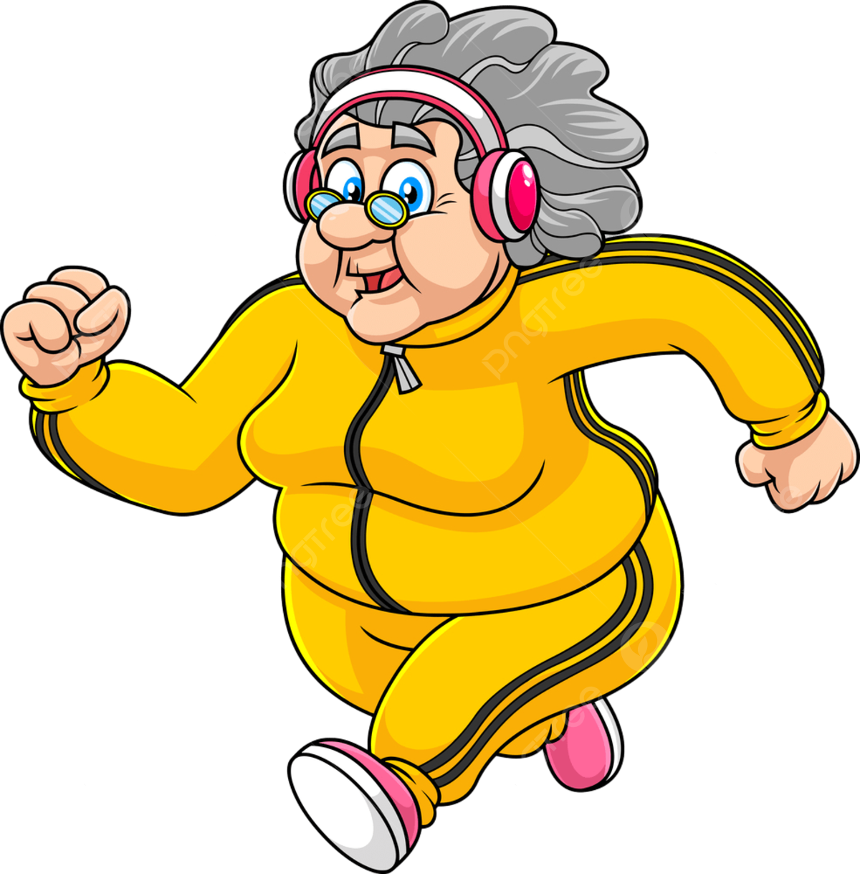
What is
Pulmonary Rehabilitation?
Exercise and education programme designed for people with lung disease who experience symptoms of breathlessness.
Two gentle exercise sessions per week
Lasting around 90 minutes
Involves walking and light resistant (dumbbells) or body weight movement exercises
In a group up to 12 - 16 people who have similar respiratory conditions

Slide 4
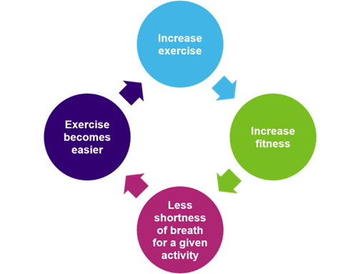

What do you get out of it?
Evidence shows that accessing PR improves people’s ability to walk further
feel less tired
Feel less breathless when carrying out day-to-day activities
90 per cent of patients who complete a PR programme have higher activity and exercise levels, and report an improved quality of life.

Slide 5
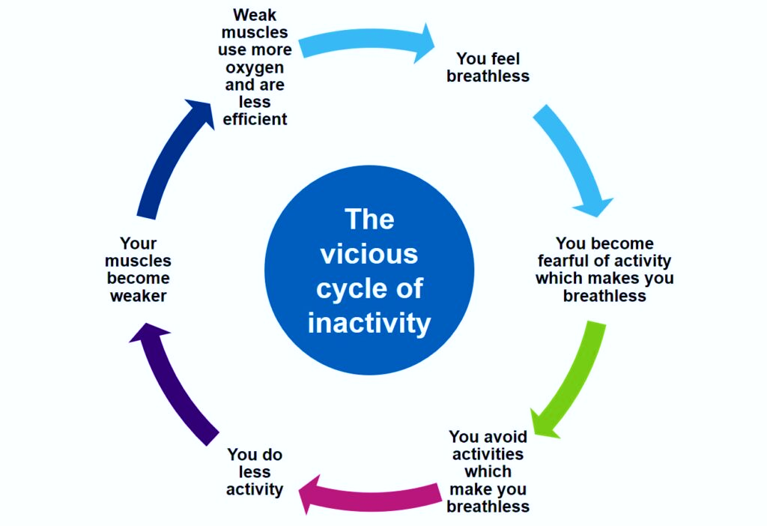
What happens if you don’t do it?
Your muscles will get weaker
They become less efficient at using oxygen
You become more breathless

Slide 6
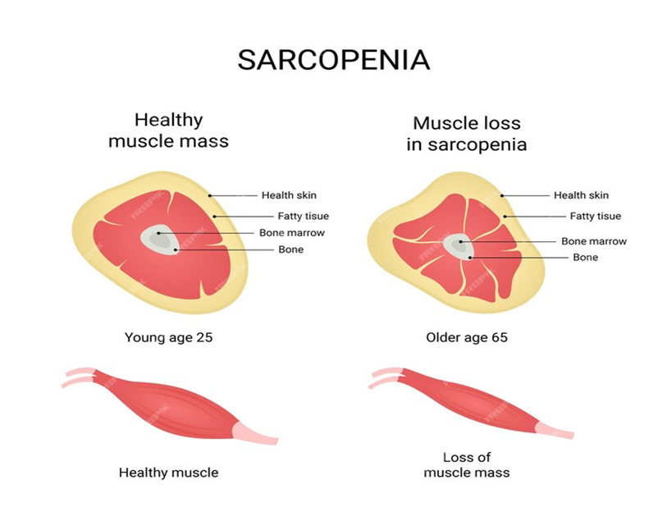
Sarcopenia
A term proposed by Rosenburg (1989) from the Greek term (‘sarx’ or flesh + ‘penia’ or loss).
A syndrome characterised by progressive and generalised loss of skeletal muscle mass and strength which is strictly correlated with physical disability, poor quality of life and death
The condition can best be understood as a skeletal muscle failure or insufficiency.
Two types:
- Primary sarcopenia (age related) in the absence of any other cause
- Secondary sarcopenia when causal factors other than the normal aging process are evident

Slide 7
Sarcopenia
In a study by the European Respiratory Society (2019) it was found that ~22% of those with COPD had Sarcopenia.
Worldwide it is estimated that by 2050 the number of people with sarcopenia will reach 500 million, causing concern worldwide due to impact on healthcare cost and burden (Liu et al, 2024).
In the UK at present approx. 2.7 million people have had a diagnosis of sarcopenia already.

Slide 8
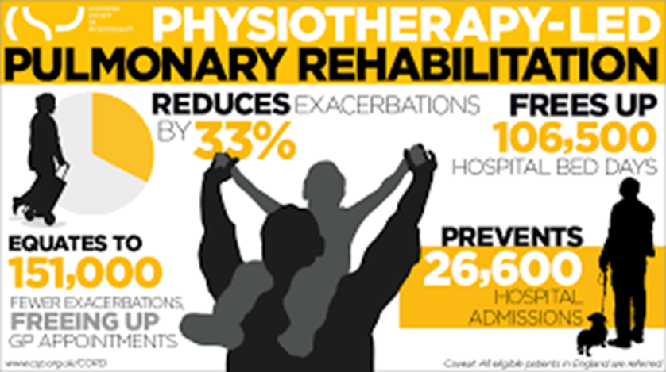
Proven benefits of PR
Reduce Hospital admissions
Reduce visits from the Respiratory Team (Oxygen Nurses, Social Prescribers, Physios)
Improve Exercise
Reduce Shortness of Breath/Breathing difficulties
Improve strength & endurance
Reduces the risk of Sarcopenia & Frailty

Slide 9
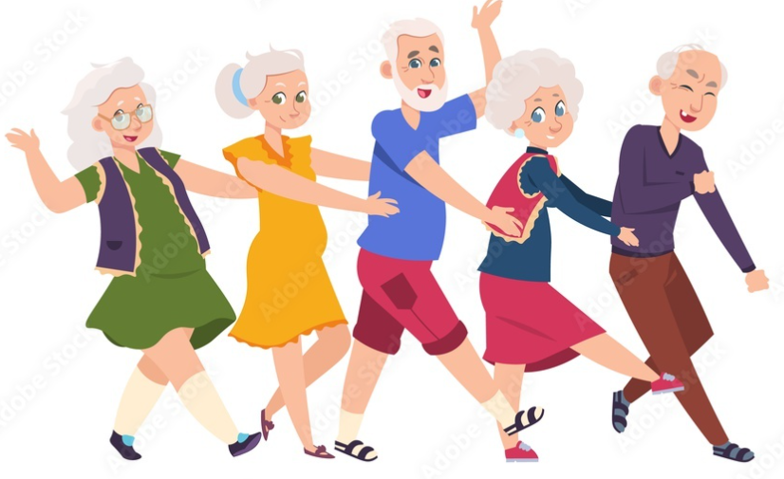
So!! Pulmonary Rehab
Will help to:
Improve your health
Improve daily activities
Improve your mood
Give you a better understanding of Lung Disease
improve self care
Improve your quality of life

Slide 10
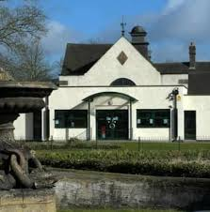
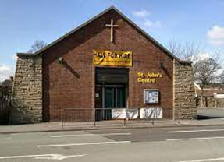
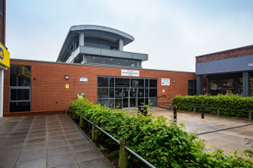
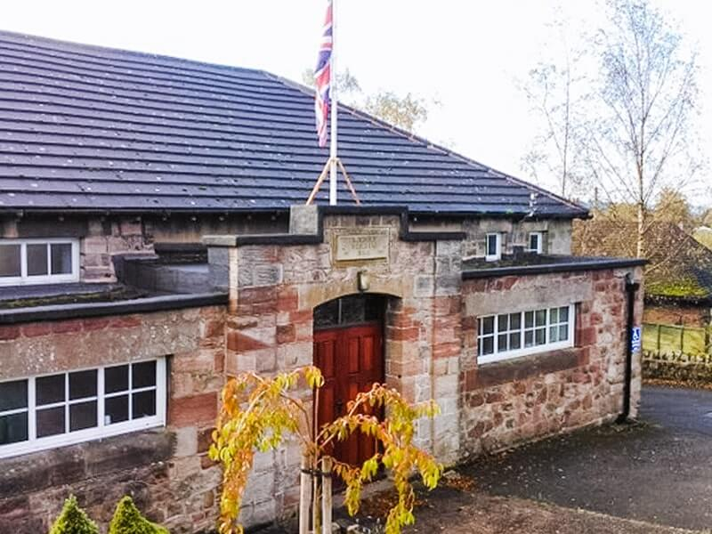
Where are we in:
Stoke-on-trent & North Staffordshire?
Floral Hall, Tunstall
St. John’s Centre, Trent Vale
Bentilee Neighbourhood Centre
Longsdon Memorial Hall, Leek

Slide 11
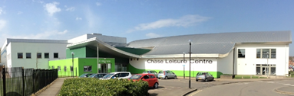
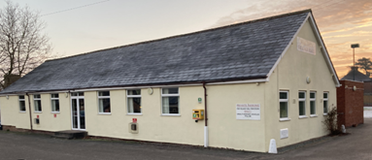
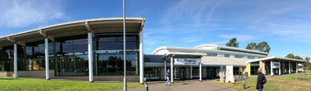
Where are we in:
South Staffordshire?
Cannock leisure centre
Walton village hall
Rugeley leisure centre

